Slide 1




OSTAD of API
Connecting Systems, Empowering Innovation

Slide 2

The Role of API in Connectivity
APIs act as bridges between disparate software systems.
Functional
Security
Defines how features and integration points operate.
Handles OAuth, JWT tokens, and API keys for access.
Protocols
Validation
Utilizes REST or SOAP to structure data exchange.
Ensures correct status codes and accurate data.

Slide 3

Client-Server Communication Overview
The fundamental request-response cycle driving modern web architecture.
The Client (Requester)
Initiates communication by sending requests (e.g., HTTP/HTTPS) for resources or actions.
The Server (Responder)
Waits for requests, processes logic, and serves back the required data or status codes.
Protocol: HTTP, WebSocket, or TCP

Slide 4

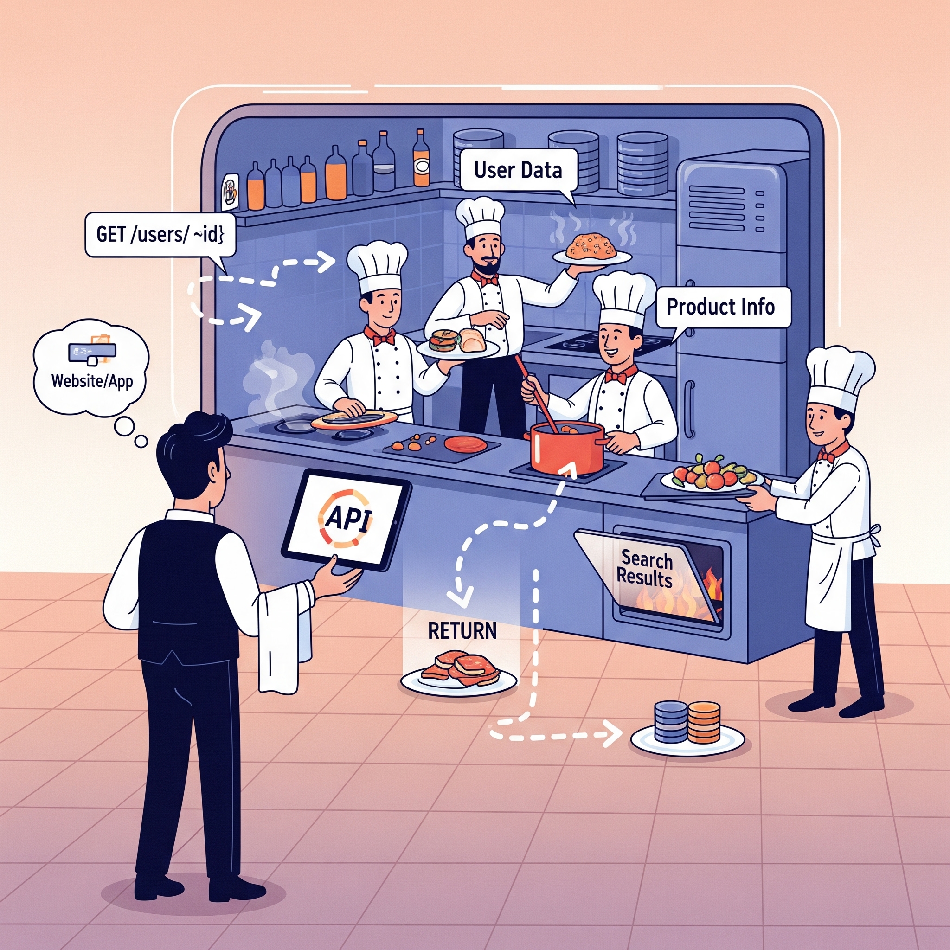
The API Kitchen Metaphor
Visualizing how Application Programming Interfaces manage requests and data flow between users and servers.
The Waiter (API)
Acts as the messenger taking your request (order) to the kitchen (server) and bringing back the response (food).
The Kitchen (Server)
Processes the logic, retrieves data from the pantry (database), and prepares the final result.
The Menu (Documentation)
Specifies what requests are possible, what parameters are needed, and what will be returned.

Slide 5

The Request-Response Lifecycle
Understanding the bidirectional flow of information in a standard API interaction.
1. The Request (Order)
The client sends a message containing the method (GET/POST), endpoint, and required headers or body data.
2. The Response (Delivery)
The server returns data (usually JSON/XML) along with a status code (e.g., 200 OK) to confirm the outcome.
Data Format: JSON, XML, or HTML

Slide 6


Key Components of an API Request
Breaking down the structural elements required for a successful client-to-server call.
Method (Action)
The operation to perform (e.g., GET, POST, PUT, DELETE).
URL/Endpoint
The specific address where the resource is located.
Headers (Metadata)
Key-value pairs for auth, content type, and caching.
Body (Data Payload)
The actual data sent to the server (typically JSON).

Slide 7

Understanding the API Response Structure
The server's answer contains critical metadata and data to confirm the request outcome.
1. Status Code
Indicates the success or failure of the request (e.g., 200 OK, 404 Not Found).
2. Response Headers
Metadata about the response, such as Content-Type, server info, and cache policies.
3. Response Body
The actual data payload, typically formatted as JSON, XML, or HTML.

Slide 8

Understanding JSON Format
JavaScript Object Notation is the standard data exchange format for modern APIs.
Key-Value Pairs
Data is organized in "key": "value" structures.
Data Types
Supports strings, numbers, booleans, arrays, and objects.
Lightweight Syntax
Minimalist structure using braces {} and brackets [].
Primary Use Case: REST API Payloads

Slide 9


API & Database Interaction
APIs act as a secure gateway, managing how data is retrieved, stored, and updated in the database.
1. Data Querying
The API receives a request and translates it into a database query (e.g., SQL) to find specific records.
2. Processing Logic
The server processes the retrieved data, applying business rules or filtering before sending it back.
3. State Persistence
For POST/PUT requests, the API ensures data integrity while writing new information to the database.

Slide 10

Common HTTP Methods in API Requests
Understanding the standard verbs used to define actions on resources within Postman and modern APIs.
GET (Read)
Retrieves data from a server without modifying it.
GET /users/123
POST (Create)
Sends new data to the server to create a resource.
POST /users
PUT (Update)
Updates an existing resource with new information.
PUT /users/123
DELETE (Remove)
Permanently removes a specific resource from the server.
DELETE /users/123

Slide 11

Hands-on API Calls with Postman
Follow these core steps to execute your first API request and inspect the results.
1
Set Method & URL
Select GET and enter the API endpoint.
2
Configure Params
Add keys and values to the Params tab.
3
Send & Analyze
Hit 'Send' and check the Status and Body.
Tip: Use 'Prettify' to read JSON responses easily.

Slide 12

Authentication & Security Basics
APIs use authentication to ensure only authorized users can access sensitive data and services.
API Keys
A unique identifier used to authenticate a project and track usage.
Bearer Tokens (OAuth 2.0)
Secure tokens often sent in the Authorization header for user access.
Basic Auth
A simple method using username and password encoded in Base64.
Best Practice: Never hardcode keys in client-side code.

Slide 13

Advanced API Security Concepts
Moving beyond basic authentication to robust protection strategies for production environments.
Rate Limiting & Throttling
Prevents abuse by limiting the number of requests a user can make.
Input Validation
Always sanitize data to prevent SQL Injection and XSS attacks.
Mutual TLS (mTLS)
Two-way authentication where both client and server provide certificates.
Key Rotation: Regularly update API keys to minimize breach impact.

Slide 14

Authoritative Sources for API Testing
Identifying the correct technical documentation to design effective tests and ensure data fidelity.
Swagger / OpenAPI Docs
The primary authoritative source for endpoints, parameters, and error codes.
Database Dictionary
Use for verifying schema, table relationships, and data integrity constraints.
DevOps Environment Docs
Access secure environment URLs, credentials, and production configurations.
Key Principle: Design tests based on documentation, not verbal assumptions.

Slide 15

Core Architecture & Integration
Understanding how APIs bridge disparate systems through structured data exchange and logic.
Data Querying
Translates requests into database queries to retrieve specific records efficiently.
Processing Logic
Applies business rules and filters to data before sending it back to the requester.
State Persistence
Ensures data integrity during POST/PUT operations when writing to the database.
Insight: APIs act as secure gateways for all backend interactions.

Slide 16

Error Handling & Status Codes
Standardized HTTP status codes help developers identify the success or failure of an API request.
2xx Success
Indicates that the request was received, understood, and accepted by the server.
4xx Client Error
The request contains bad syntax or cannot be fulfilled (e.g., 404 Not Found).
5xx Server Error
The server failed to fulfill an apparently valid request due to an internal error.
Pro Tip: Always return descriptive JSON error messages for debugging.

Slide 17

Postman Workspace Essentials
Workspaces provide a collaborative environment to organize API projects, collections, and environments efficiently.
Collections & Folders
Group related APIs in a sequence to automate testing workflows and manage data flow.
Environment Variables
Reuse values across requests to eliminate hardcoding and switch between staging/prod easily.
Scripting (Pre/Post-Request)
Automate data extraction and validation using JavaScript to catch backend bugs instantly.
Key Benefit: Ensures a clean, organized, and scalable automated testing workflow.

Slide 18

Understanding Postman Collections
Collections group related API requests into a single folder to simplify organization, testing, and automation workflows.
Logical Grouping
Organize APIs by project or service to keep your workspace clean and manageable.
Execution Sequences
Run multiple APIs in order (e.g., Login > Get User > Update) using the Collection Runner.
Automated Validation
Apply tests and scripts at the collection level to validate every request automatically.
Key Principle: Collections are the foundation for CI/CD integration using tools like Newman.

Slide 19

Managing Variables & Scopes
Postman uses variables to store and reuse values across requests, enabling dynamic testing and multi-environment support.
Collection Variables
Specific to a single collection; ideal for constants like API versions or auth paths.
Environment Variables
Allow switching between Staging, Dev, or Prod URLs without modifying request URLs.
Global Variables
Accessible across all collections in a workspace; best for shared high-level config.
Syntax: Use double curly braces {{variable_name}} to reference variables.

Slide 20

Postman Request & Response
Every API interaction in Postman consists of a defined request sent to a server and the resulting response returned.
Request Components
Includes the URL, HTTP Method (GET, POST, etc.), Headers, and Body data sent to the API.
Response Details
Contains the Status Code, Response Body (usually JSON), Headers, and performance time.
Authorization & Params
Manage API keys or tokens in the Auth tab and use Query Params for filtering resources.
Workflow: Build Request > Send > Inspect Response > Save as Example.

Slide 21


Thank You!
Empowering the next generation of API Experts
Abdullah Al Rumy
Lead Instructor, OSTAD Platform

